Slide 1
Assignment 2: Pacemaker
Group 26: Sherjeel shehzad and kevin tang

Slide 2
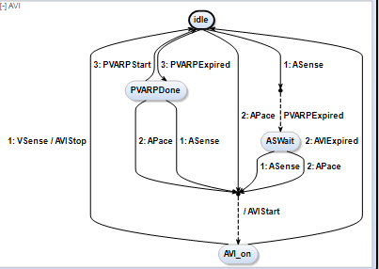
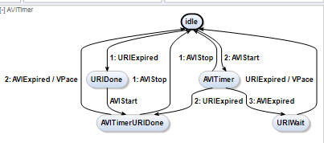
AVI and AVITimer (Atrioventricular Interval)
Maximum time between Atrial Event and its subsequent Ventricular Event

Slide 3
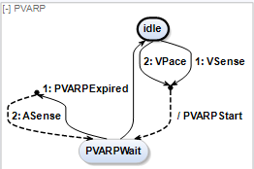
PVARP (Post-Ventricular Atrial Refractory Period)
Time after a Ventricular Event where any Atrial Events are ignored as Atrial Refractory (AR) signal

Slide 4
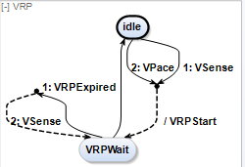
VRP (Ventricular Refractory Period)
Time after a Atrial Event where any Ventricular Events are ignored as Ventricular Refractory (VR) signal

Slide 5
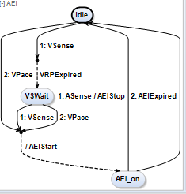
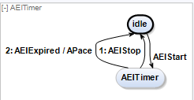
AEI and AEITimer (Atrial Escape Interval)
Maximum time between a Ventricular Event and its subsequent Atrial Event

Slide 6
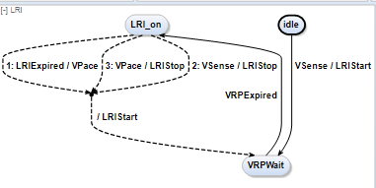
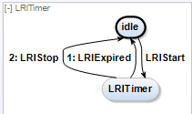
LRI and LRITimer (Lower Rate Interval)
Slowest rate the heart is allowed to operate. This is the time between the Ventricular Events

Slide 7
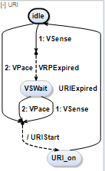
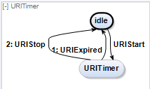
URI and URITimer (Upper Rate Interval)
Fast rate the heart is allowed to operate. This is the time between the Ventricular Events

Slide 8
Time
Total time spent on this assignment: ~16 hours (mainly debugging)

